Slide 1

Team 1
Social Cart
Converse. Compare. Checkout.

Slide 2


About
App name Social Cart
Our application, Social Cart,aims to provide a platform for users to communicate their ideas while promoting healthy discussions amongst different people around the globe. It provides the easiest way for anyone to buy products at the cheapest possible price.

Slide 3
Team members

Slide 4


Meet Rajeev
Android developer. Will be working in JAVA, XML and JSON.
Info
Roll no - 09917702016
Class - BCA 3B

Slide 5


Meet Rishabh
Front end web developer, proficient in HTML, CSS and JavaScript.
Info
Roll no - 10217702016
Class - BCA 3B

Slide 6

Meet Sanil
Android and Python programmer. Will provide his skill in JAVA and Python.
Info
Roll no - 11417702016
Class - BCA 3B

Slide 7
Meet Shreyans
Web developer, will be providing his skills in JavaScript and Python.
Info
Roll no - 11717702016
Class - BCA 3B

Slide 8

Problem :
How to search for the best products at the cheapest price & be certain about it.

Slide 9
PRESENTING
SOCIAL CART
Converse.
Compare.
Checkout.

Slide 10
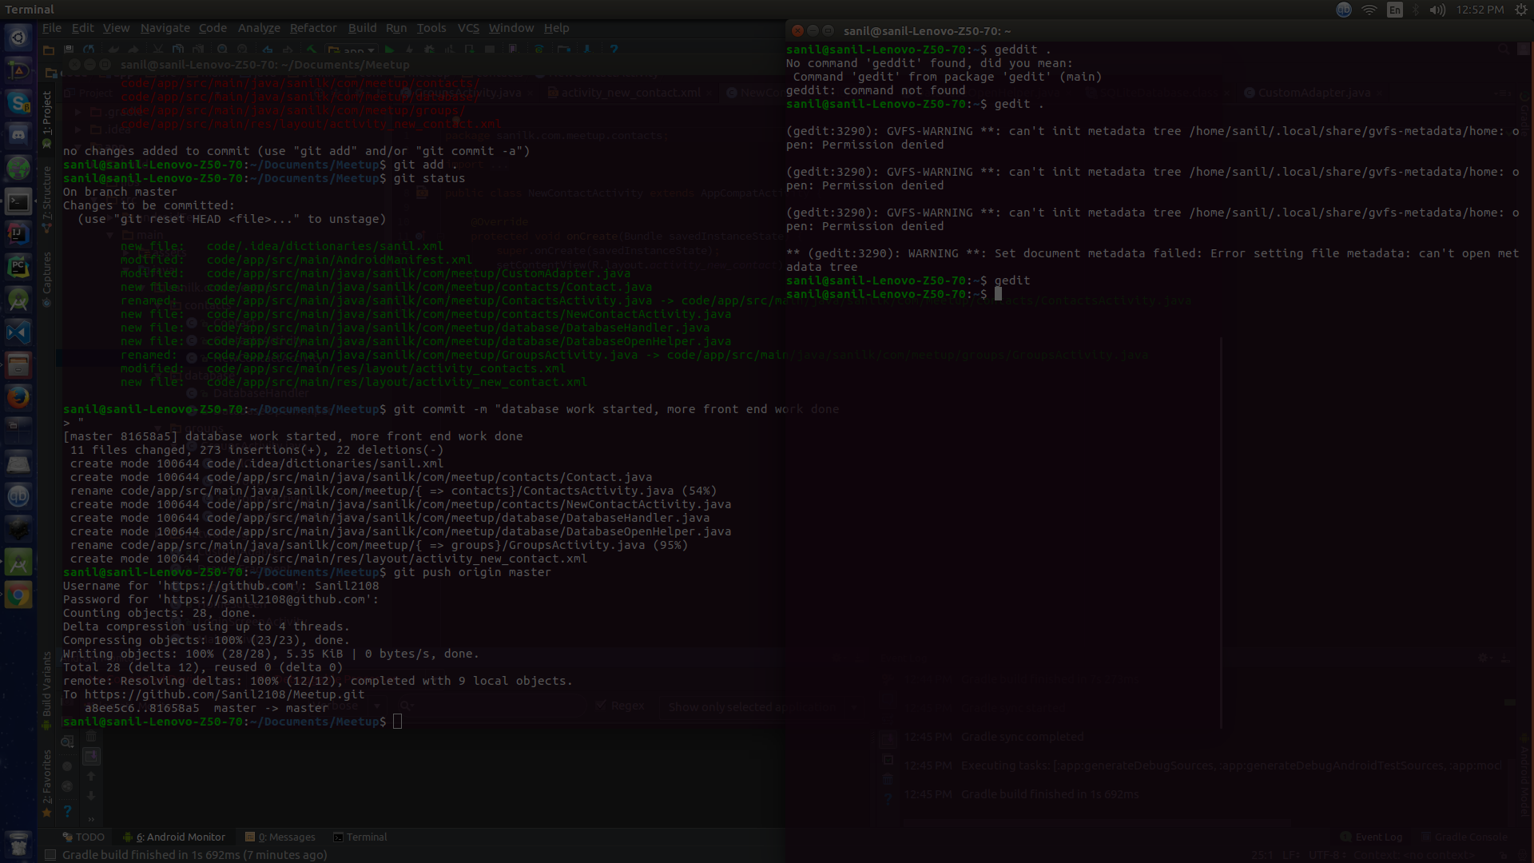
Board
Discuss what you want before you want it.

Slide 11
What people are discussing
GeForce GTX 1080 Ti or RX VEGA ??
Sanil Khurana
IPhone 7s or Samsung Galaxy S8 ??
Rishabh Jain
Which operating system to choose??
Shreyans Jain

Slide 12
Objectives of Board.
Allows easy integration with Facebook.
Promotes and encourages healthy discussions for the benefit of all.
Users will have the ability to create groups on various topics, such as technology, fashion, household items etc.

Slide 13
Closeout
Find the lowest prices online.

Slide 14
Objectives of Closeout.
It provides easy navigation and option to choose from various e-commerce websites.
Ensures that users buy at the best possible price.
This way, people can buy what they want by comparing products on different websites, such as amazon.in, amazon.to, AliExpress.

Slide 15

Programming Languages And technologies used
Front-End
Android
HTML
CSS
JavaScript
JQuery
Java
XML
SQLite Database
Back-End
Scraping
Python with Flask
JSON and XML
SQLite Database
Python with bs4, Requests.

Slide 16
return 0;

